Slide 1
Recommendation System for Airbnb listings
Ioannis Petromichelakis
Applicant for The Data Incubator Fellowship program

Slide 2
Outline
Motivation, assumptions and objectives
Yelp Challenge Dataset (5.5GB) from yelp.com
Airbnb Listings in Toronto and Montreal (200MB) from insideairbnb.com
Data:
Yelp Challenge Dataset (5.5GB) from yelp.com
Airbnb Listings in Toronto and Montreal (200MB) from insideairbnb.com
Yelp reviews
Yelp business data
Airbnb listings
User keywords
Sentiment Analysis
Positive Yelp reviews
TF-IDF 1
Geographical Clustering
Identify areas with high density of restaurants, bars, coffee shops, etc. and calculate TF-IDF vectors
Recommendation score
Based on cluster/keywords relevance and on listing’s proximity to the cluster center
Airbnb neighborhood description
TF-IDF 2

Slide 3
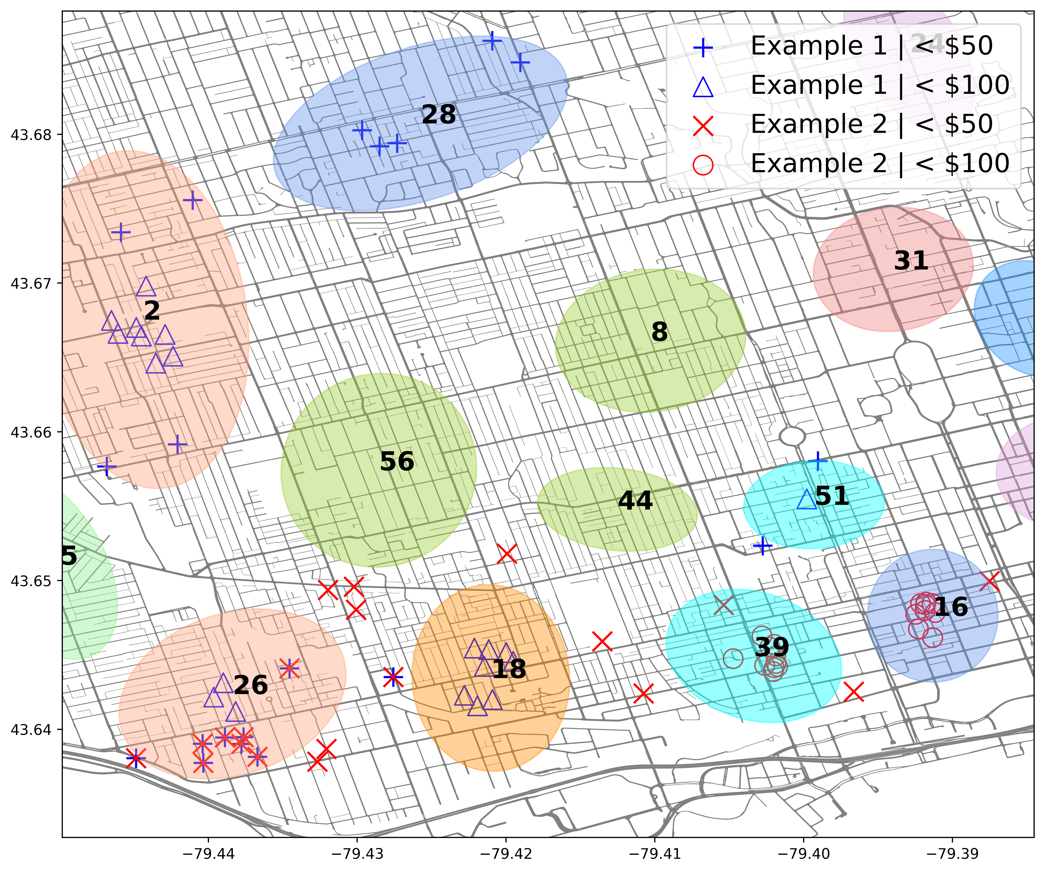
Results - Toronto
Example 1: ‘hipster’, ‘hippy, art,…
Example 2: clubs, nightlife,…
Cluster | Scr 1 | Scr 2 | # listings | Av. Price | Neighborhoods
2 | 6.6 | 2.3 | 279 | $101.33 | Dovercourt-Junction | 69%
 |  |  |  |  | Corso Italia-Davenport | 21%
16 | 2.8 | 5.0 | 794 | $204.44 | Waterfront Communities | 94%
18 | 6.8 | 3.8 | 487 | $177.35 | Little Portugal | 37%
 |  |  |  |  | Niagara | 33%
 |  |  |  |  | Trinity-Bellwoods | 19%
26 | 6.1 | 4.2 | 319 | $125.96 | Roncesvalles | 40%
 |  |  |  |  | South Parkdale | 38%
 |  |  |  |  | Little Portugal | 18%
28 | 4.1 | 1.6 | 125 | $119.88 | Wychwood | 53%
 |  |  |  |  | Humewood-Cedarvale | 22%
39 | 3.5 | 5.1 | 769 | $199.43 | Waterfront Communities | 68%
 |  |  |  |  | Niagara | 20%
44 | 3.1 | 3.7 | 174 | $141.52 | Trinity-Bellwoods | 53%
 |  |  |  |  | Palmerston-Little Italy | 38%
51 | 6.4 | 1.9 | 250 | $122.03 | Kensington-Chinatown | 98%

Slide 4
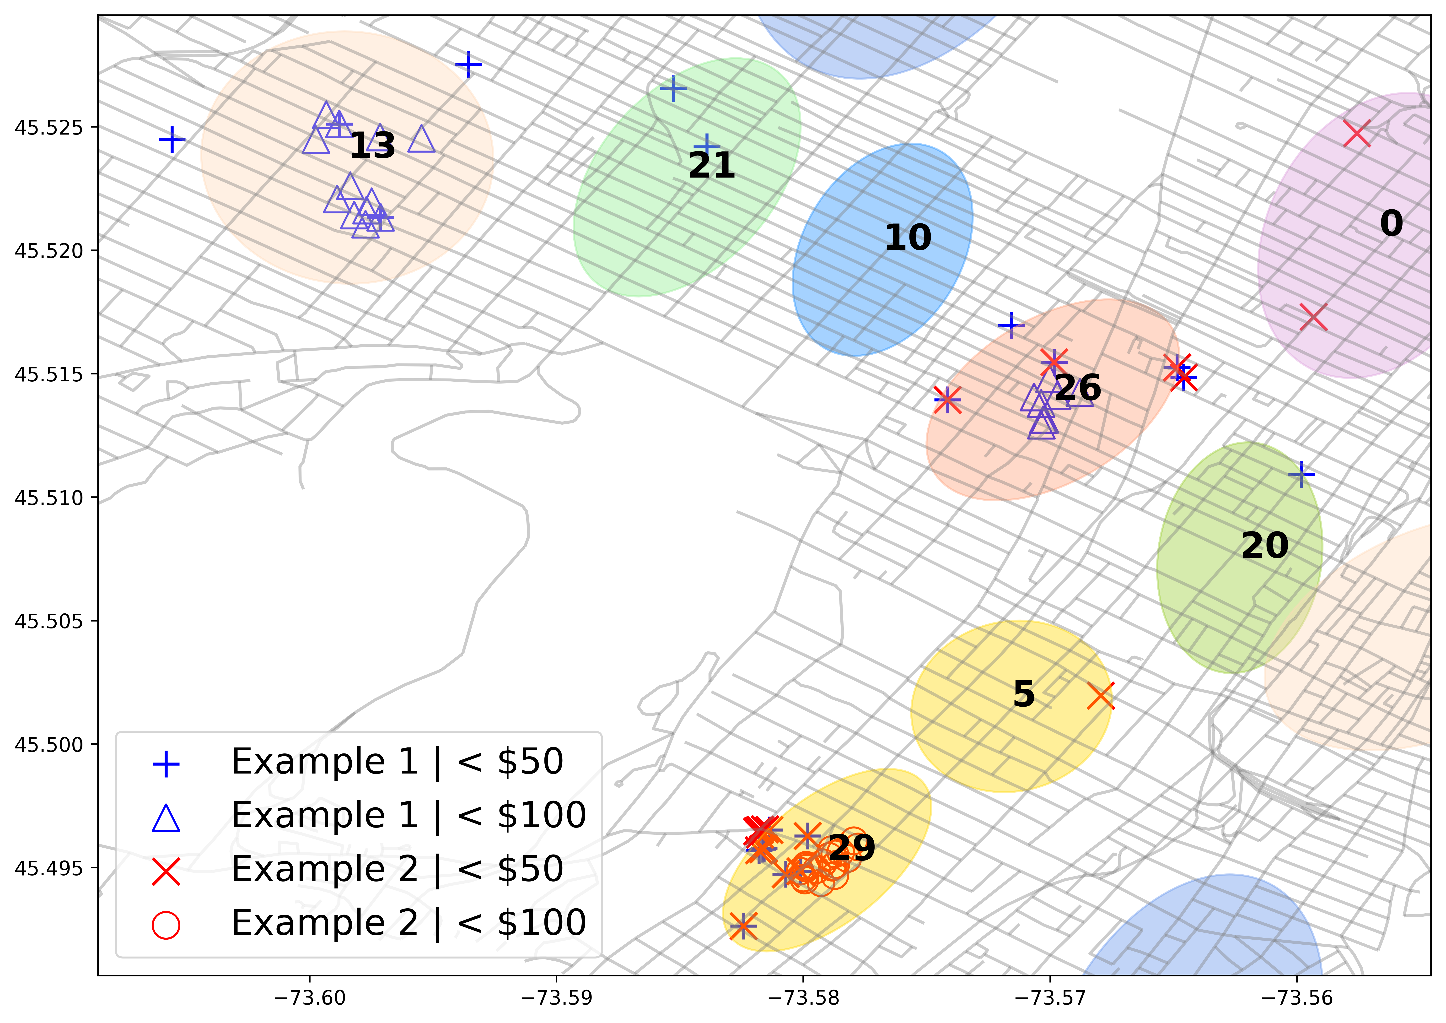
Results - Montreal
Example 1: hipster, hippy, art,…
Example 2: clubs, nightlife,…
Cluster | Scr 1 | Scr 2 | # listings | Av. price | Neighborhood
0 | 4.5 | 7.4 | 787 | $109.20 | Ville-Marie | 100%
5 | 5.8 | 8.8 | 325 | $186.20 | Ville-Marie | 76%
 |  |  |  |  | Le Plateau | 24%
13 | 10.3 | 5.3 | 603 | $122.17 | Le Plateau | 77%
 |  |  |  |  | Outremont | 14%
20 | 8.0 | 6.4 | 453 | $158.07 | Ville-Marie | 100%
21 | 6.6 | 5.5 | 691 | $115.44 | Le Plateau | 99%
25 | 5.3 | 7.0 | 420 | $187.64 | Ville-Marie | 98%
26 | 8.3 | 8.2 | 823 | $159.81 | Le Plateau | 70%
 |  |  |  |  | Ville-Marie | 30%
29 | 6.4 | 9.3 | 728 | $125.02 | Ville-Marie | 99%

Slide 5
Outline
STEP 1
STEP 2
STEP 3
Yelp reviews
Yelp business data
User provided keywords
Sentiment Analysis
Geographical Clustering
Vectors U1, U2 in TF-IDF 1,2
Positive Yelp reviews
TF-IDF 1
For cluster i:
Vectors V1(i), V2(i) in TF-IDF 1,2
Fit a 2D Gaussian: G_{i}(.)
For cluster i similarities:
V1(i) - U1 and V2(i) - U2
Combine: Uscore(i)
Airbnb neighborhood description
TF-IDF 2
Recommendations
Pick N Airbnb listings with:
max Σ_{i} G_{i}(x)*Uscore(i)
Airbnb listings data

